Slide 1
DCD Mini-Project
Digital electronic implementation of multi-layer perceptron Application in brain tumour detection
Batch 1 :-
23ECB0A01
23ECB0A02
23ECB0A03

Slide 2
INDEX :
Abstract/Introduction
Motivation & Why hardware implementation
Theory -> 1.MLP
2.Activation functions
3.Feature map generation
4.Nearest Neighbor interpolation
IV. Workflow
V. Code (in external document/pdf)
VI. Output
VII. Results and conclusions
VIII. References

Slide 3
Abstract/Introduction
The early detection of brain cancer significantly influences treatment efficacy and patient survival rates. This project presents an innovative approach using Multi-Layer Perceptron (MLPs) to analyse MRI brain scans, effectively classifying them into categories with or without tumours.
This project aims to design a hardware system to classify brain tumours from MRI scan images among multiple types of tumours.

Slide 4
Motivation & Why hardware implementation
Training doctors is a costly process, with estimates suggesting it can take upwards of
1.1M$(in USA) to fully train a single doctor over several years. At the same time, India faces a shortage of over 600,000 doctors and more than 2 million nurses, according to recent healthcare statistics. The lack of medical facilities in rural and underserved areas further compounds this issue, leading to increased patient loads and delayed diagnoses for critical conditions like brain tumors.
This system aims to address these challenges by providing an automated solution for detecting brain tumors from MRI images, potentially reducing diagnosis time by a substantial margin and making quality healthcare more accessible. Implementing this project using a hardware language like SystemVerilog enhances processing speed and reduces computational power requirements. FPGA-based solutions, in particular, can operate several times faster than traditional CPU-based solutions for image processing tasks while consuming significantly less power.
This efficiency leads to significant cost savings, as these systems may operate at a fraction of the expense of traditional diagnostic equipment.Developing such systems from low level components (I.e. on FPGA boards/Basic languages such as Verilog/VHDL/SystemVerilog) helps increase the speed and decreases computation power required as well as decrease the power consumption

Slide 5
Theory
Multi-Layer perceptrons
Activation functions
Feature map generation
Nearest neighbor interpolation

Slide 6
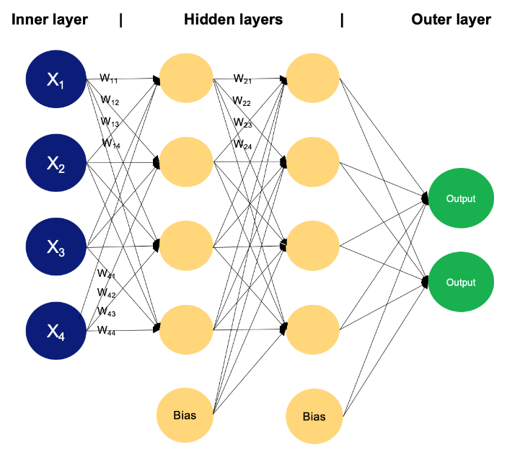
1.Multi-Layer perceptron
Multi-layer perceptrons are feed forward neural networks containing generally 3 or more layers.
They are fully connected in nature (i.e. each node in previous layer is connected to every other node in the next later)
Each node in multi-layer perceptron contains a value that is obtained as a summation of the activation of the nodes in the previous layer multiplied with a certain value.
Multi-layer perceptrons are the most popular type of networks used in deep learning.
Generally, non-linear functions are used in multi-layer perceptrons.
Multi-layer perceptrons can be trained mathematically via back propagation.
Fig1.Multi-Layer perceptron
Source: - DataCamp

Slide 7
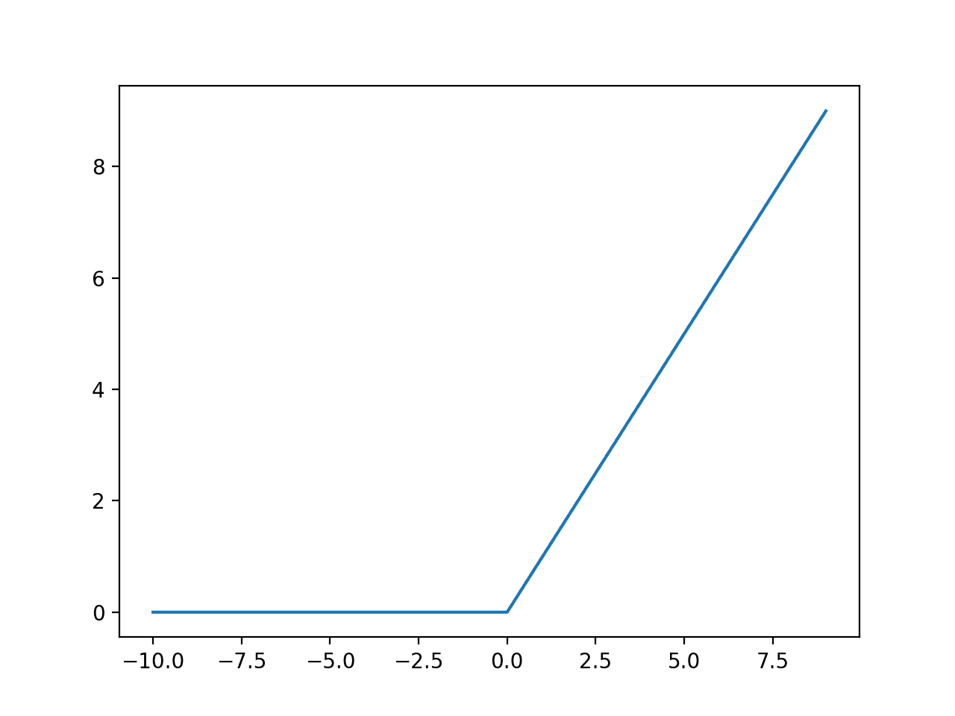
2.Activation functions
An activation function is a function in a neural network that calculates the outputs based on the input.
Generally, ReLU is used as the activation function for MLPs.
Relu helps add non-linearity to the model.
Fig2.ReLU activation function
Source: - Machine learning Mastery

Slide 8
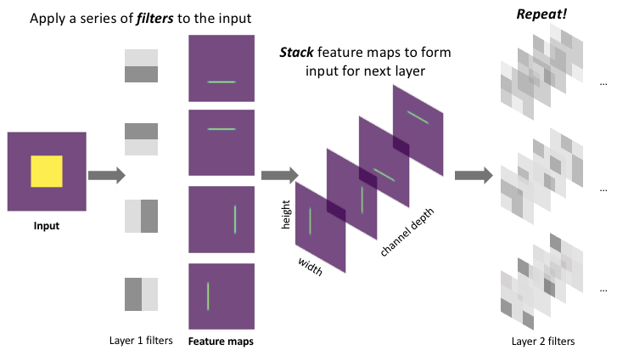
3.Feature map generation
Feature map (also called activation map) is the output array of images generated when an array of kernels/filters is passed over the original image.
Feature maps help highlight various elements of the image such as edges, diagonals, lights and shadows, certain shapes etc. In our application, ideally, the generated kernels for the feature map will be able to determine the shape of various types of brain tumours.
Fig3. Feature map generation
Source: - https://www.jeremyjordan.me/convolutional-neural-networks/

Slide 9
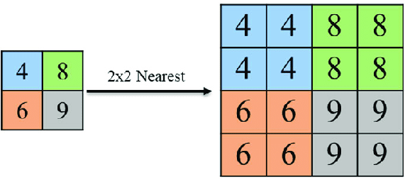
4.Nearest neighbor interpolation
To put simply, Nearest neighbour interpolation is an image resize technique. It works by finding the position of the nearest neighbouring pixel and setting the intensity value of the image to be scaled to that value
Fig4.Nearest neighbour interpolation
(Source: - ResearchGate)

Slide 10
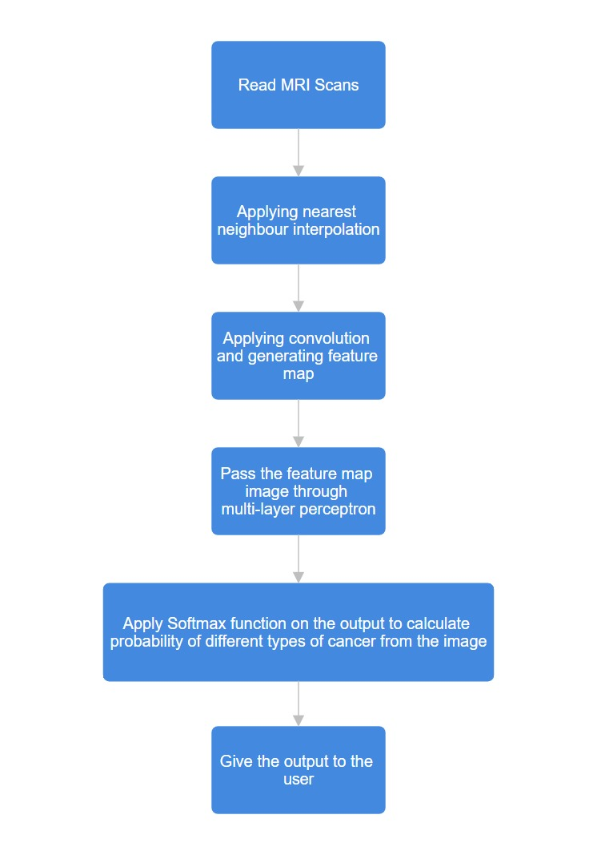
Workflow
Take MRI scan images.
Resize the images (By applying nearest neighbour interpolation).
Apply convolution and generate feature map. (optional)
Pass the feature map/image through multi-layer perceptron.
Apply SoftMax function on the output to calculate probability of different types of cancer from the image.
Give the output to the user.

Slide 11
Code
(refer to pdf file/word file for code)

Slide 12
Output
Output is of two types
1.TCL Console
2.Waveform simulation
At each posedge of clk, the TCL console outputs the chance percentage of each type of cancer in the image
At each posedge of clk, the output array in wave form simulation gives the probability of each specific type of tumour in the input array image. In the output array, index 0 denotes the probability of no cancer, 1 denotes probability of glioma, 2 denotes probability of meningioma, 3 denotes the probability of pituitary tumours.

Slide 13
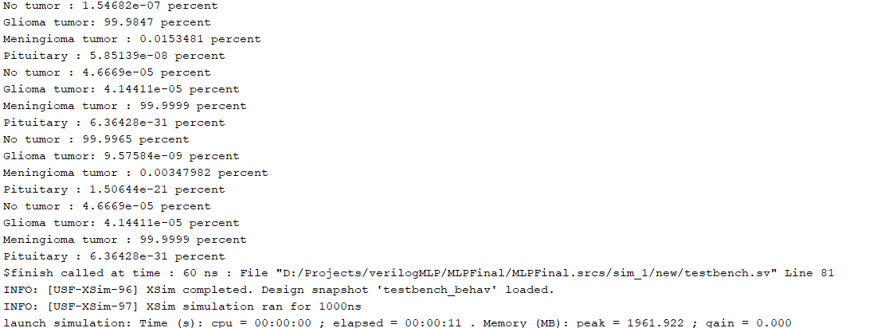
1.TCL Console output

Slide 14
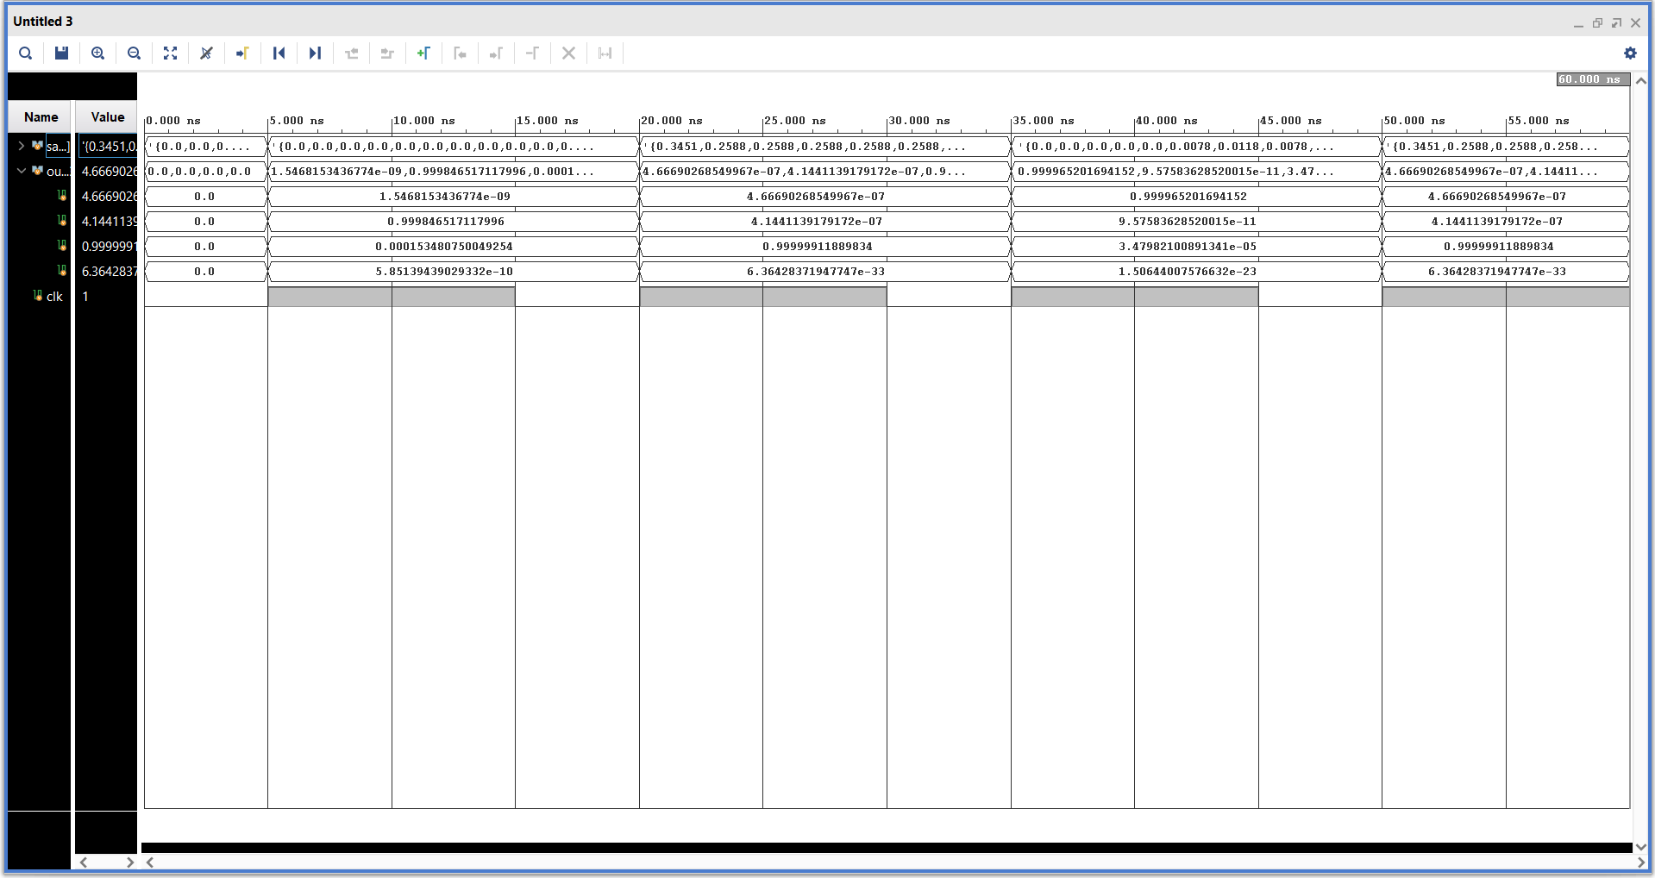
2.Wave form output

Slide 15
Results and conclusions: -
Reached moderately high accuracy in detecting exact type of cancer from MRI image.
Reached very high accuracy in determining whether the person has cancer or not from the MRI image
Unlike traditional methods which have a fixed accuracy, the accuracy of this system will increase as it gets more and more data over time.

Slide 16
References: -
Brain Tumor MRI Dataset https://www.kaggle.com/datasets/masoudnickparvar/brain-tumor-mri-dataset
News Articles Brain Tumor Deaths cost of training doctor shortage of doctors
Neural networks and deep learning from 3Blue1Brown https://youtu.be/aircAruvnKk?feature=shared
System Verilog reference from chipVerify https://www.chipverify.com/tutorials/systemverilog
Mathematical algorithm inspiration etc from pyTorch documentation https://pytorch.org/docs/stable/index.html
Nearest neighbour interpolation from Wikipedia https://en.wikipedia.org/wiki/Nearest-neighbor_interpolation

